Slide 1

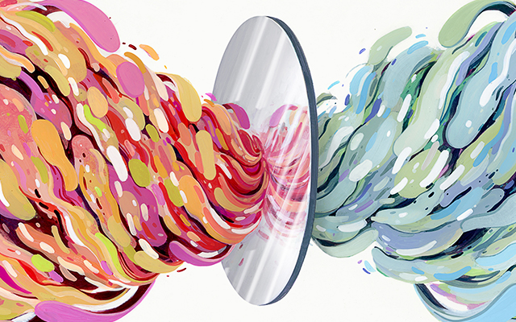
biological homochirality
Noise-Induced Symmetry Breaking
Far from Equilibrium
Physics of Complex Systems – Spring 2023
Image Credit: Quanta Magazine
Notes:
NOTE:
To change the image on this slide, select the picture and delete it. Then click the Pictures icon in the placeholder to insert your own image.

Slide 2
Homochirality: one of the universal features of life
Together with Canonical genetic code , homochirality is one of the universal features of life on Earth.
Canonical genetic code: refers to the set of rules by which the genetic information in DNA and RNA is translated into proteins.
Homochirality: the single-handedness of all biological amino acids and sugars
The only universal process common to all life is, of course, evolution, and so it is natural to seek an explanation for biological homochirality in these terms.

Slide 3
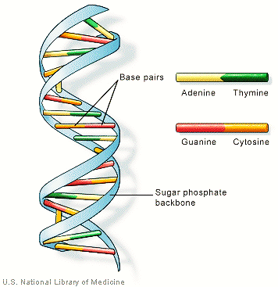
Homochirality: Where does it show itself?
The famous double helix structure of DNA is a result of the chirality of the sugar molecules in its backbone. Despite the diversity of proteins and their functions virtually all chiral biological amino acids are L-chiral, while all sugars are D-chiral.

Slide 4
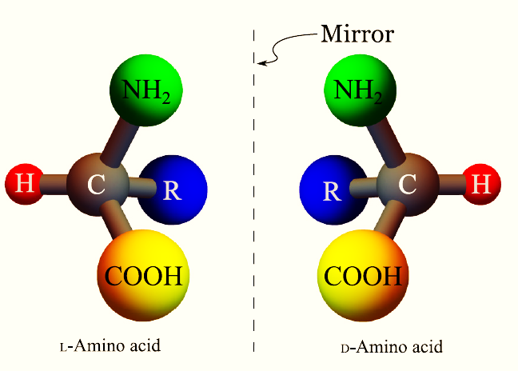
Homochirality: What does it mean?
Molecules that are not superimposable on their mirror image are called chiral (Greek for hand), and the atom surrounded by four different groups is known as the chiral center of the molecule.
Image Credit: Jafarpour et. al PhysRevE.95.032407

Slide 5
Some Homochirality Jargon
enantiomer: each category of chiral molecules. (We can think of them as a particular type of isomers)
racemic solution: solutions of 50% right-handed and 50% left-handed molecules.
homochiral solution: solution of all left-handed or all right-handed molecules.

Slide 6
The Mystery of Homochirality
Early Earth
The initial state was symmetric: solution of achiral molecules
The
laws of physics are symmetric
We expect a symmetric final state: a biosphere made of a racemic solution
of chiral molecules

Slide 7
Homochirality: An example of symmetry-breaking
A phenomenon in which the initial state and the corresponding laws of physics are symmetric with respect to a particular transformation, but the final state of the system violates that symmetry, is called a symmetry breaking

Slide 8
Homochirality: Possible Explaining Theories
Theories for symmetry-breaking problems
Homochirality
Explicit Symmetry-Breaking
- Weak interactions
- Polarized light interactions
Spontaneous
Symmetry-Breaking
Frank’s Model

Slide 9
Homochirality: Explicit Symmetry-Breaking Theories
the laws of physics are only approximately symmetric, or there is an asymmetric perturbation to the system
if life was formed from chiral organic molecules that were produced under a steady radiation of circularly polarized light, the asymmetric interaction of different enantiomers of chiral molecules with the light over hundreds of millions of years could lead to a significant enantiomeric excess
Unlike electromagnetic interactions, the weak interaction violates mirror symmetry
A common weakness of explicit symmetry-breaking mechanisms is that the homochirality achieved is only partial

Slide 10
Homochirality: Spontaneous Symmetry-Breaking Theories
the governing laws are perfectly symmetric, and as a result, the symmetric state is a final solution, but it may be an unstable solution. In this case, even the slightest perturbation to the system moves the system away from the symmetric state.

Slide 11
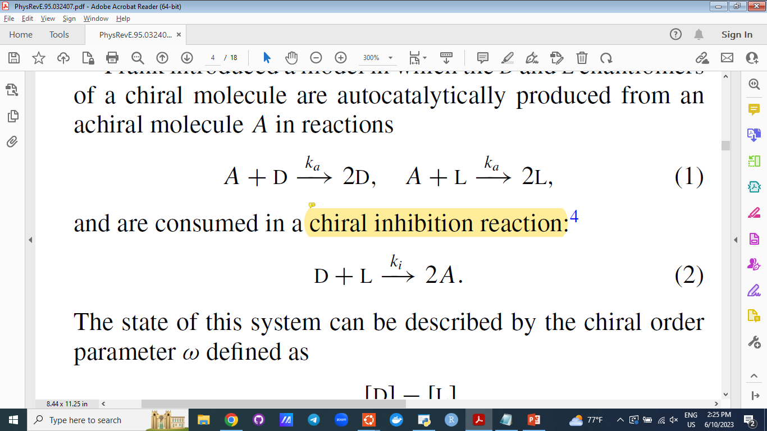
Spontaneous Symmetry-Breaking Theories: Frank’s Model
Auto-Catalysis Reaction
Chiral Inhibition Reaction

Slide 12
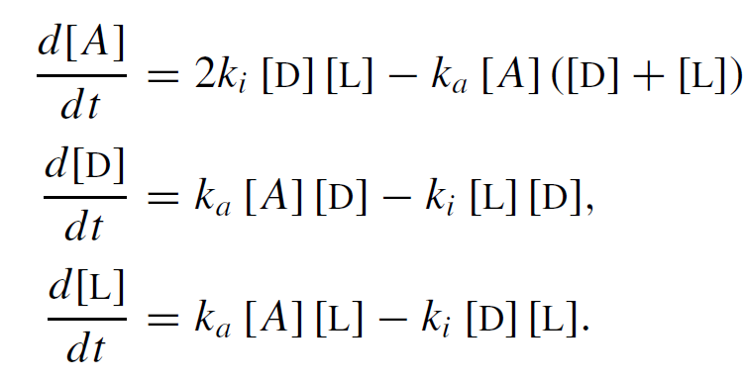
Spontaneous Symmetry-Breaking Theories: Frank’s Model
Auto-Catalysis Reaction
self-replication
Chiral Inhibition Reaction
Law of Mass Action

Slide 13
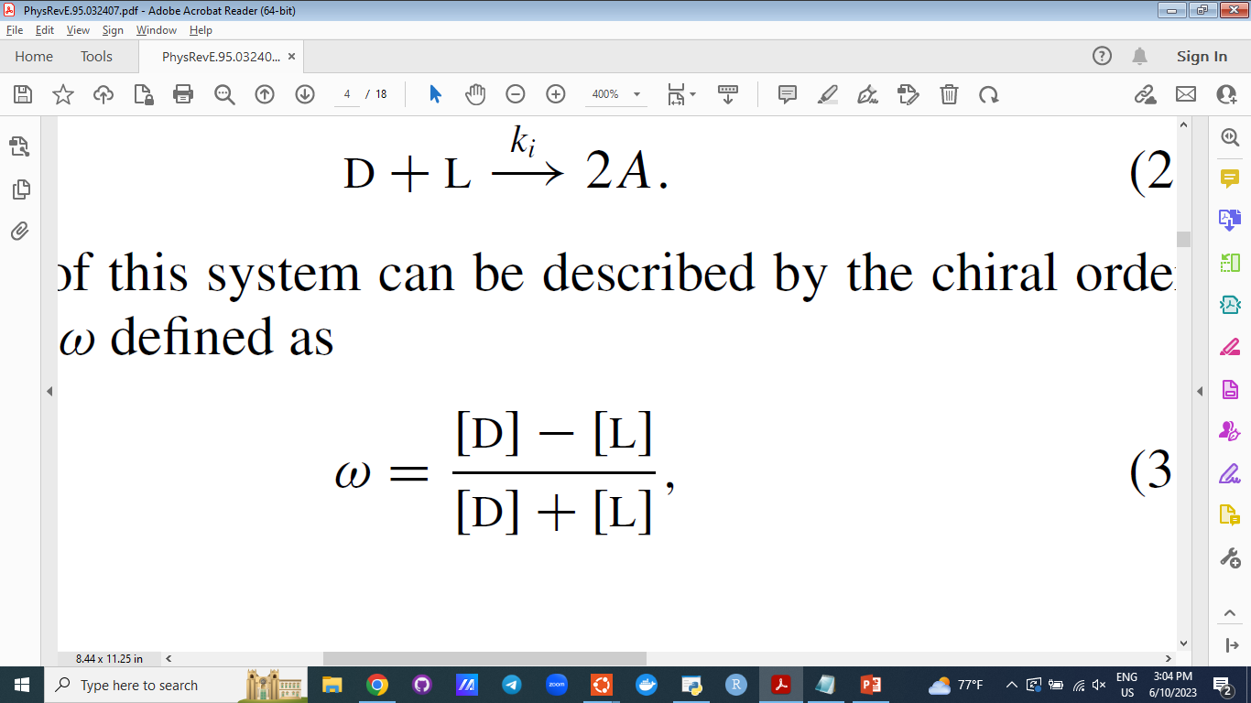
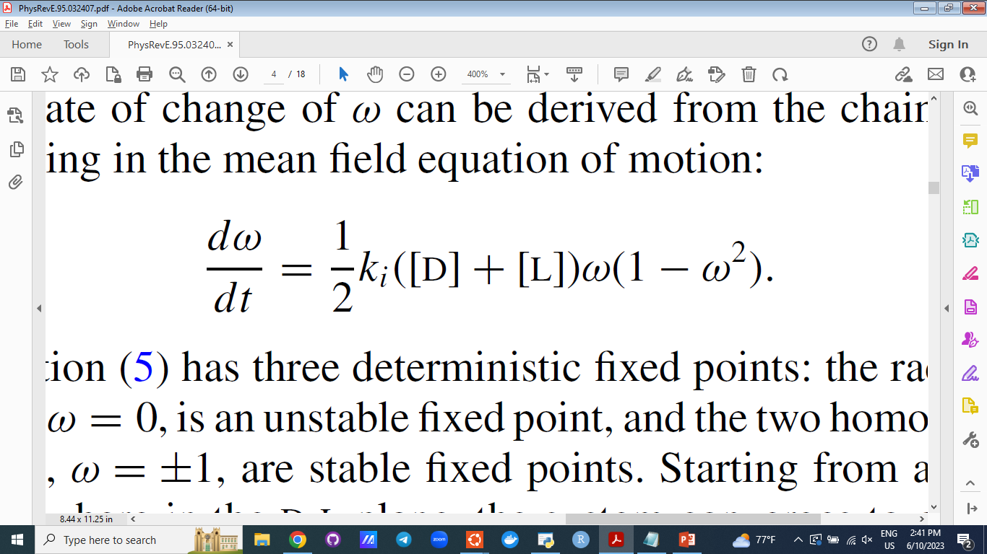
Spontaneous Symmetry-Breaking Theories: Frank’s Model
The State of the System

Slide 14
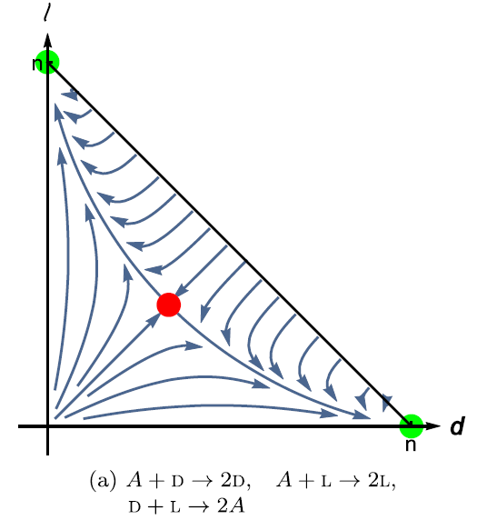
Spontaneous Symmetry-Breaking Theories: Frank’s Model
Homochiral State
The State of the System
Racemic State

Slide 15
The Problems with Frank’s Model
Although autocatalysis is an expected prerequisite for early life self- replicators, the mutually antagonistic relationship between the two chiral molecules (chiral inhibition) does not seem to be biologically necessary

Slide 16
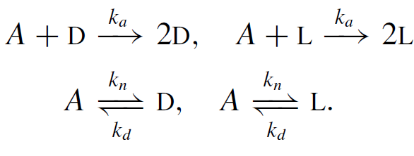
New Proposed Model
Let’s remove the chiral inhibition reaction and replace it by nonautocatalyctic and decay reactions
This model can be interpreted as a model for the evolution of early life where primitive chiral self-replicators can be produced randomly through nonautocatalytic processes at very low rates; the self-replication is modeled by autocatalysis while the decay reaction is a model for the death process.

Slide 17
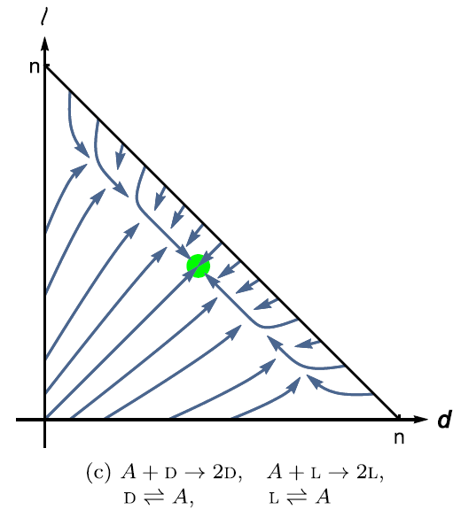
New Proposed Model: Deterministic Approach
Spoiler!
when the effect of chemical number fluctuations from self-replication is taken into account, the system can transition to homochirality when the autocatalysis is the dominant mechanism for the production of the chiral molecules
Racemic State

Slide 18
A Change of Approach: Revisiting our Assumptions
Law of mass action: the expected value of the number of collisions per unit time is proportional to the product of the concentrations of the reactants.
Near equilibrium, a system of a large number of interacting chemicals follows Boltzmann statistics and can be approximated by its expected value.
the expected value of number of collisions is used instead of the actual probability distribution of the number of collisions per unit time.

Slide 19
A Change of Approach: Far from Equilibrium Conditions
interpret the law of mass action as the probability per unit time of occurrence of a chemical reaction.
write the master equation for the rate of change of the probability of the system having given concentrations of reactants and products

Slide 20
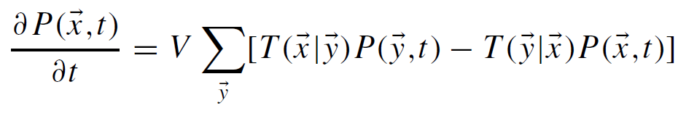
The Stochastic Model: The Master Equation
The probability to find the system at state x at time t
The transition rate from the state y to state x

Slide 21
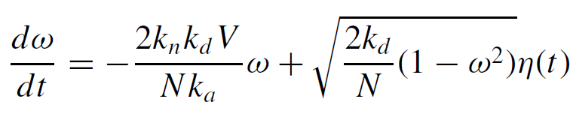
The Stochastic Model: The Langevin Equation
Deterministic Part
White noise

Slide 22
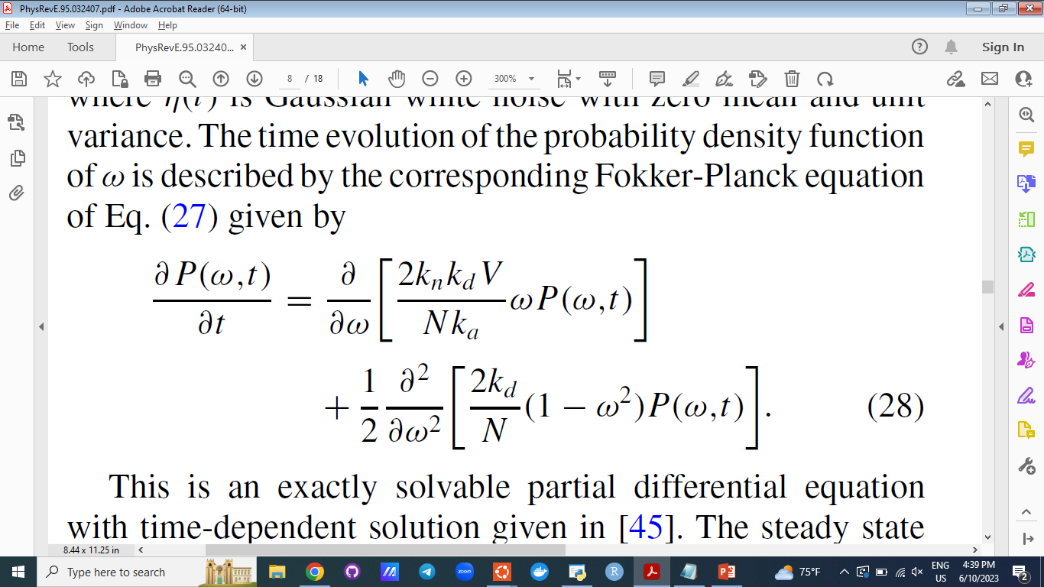
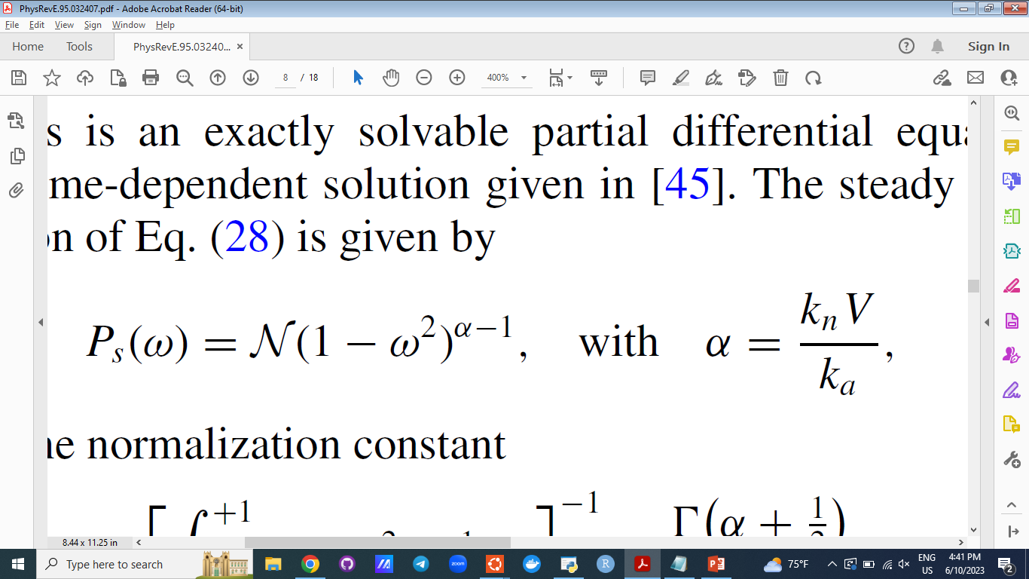
The Stochastic Model: The Fokker – Planck Equation
The Steady State Solution

Slide 23
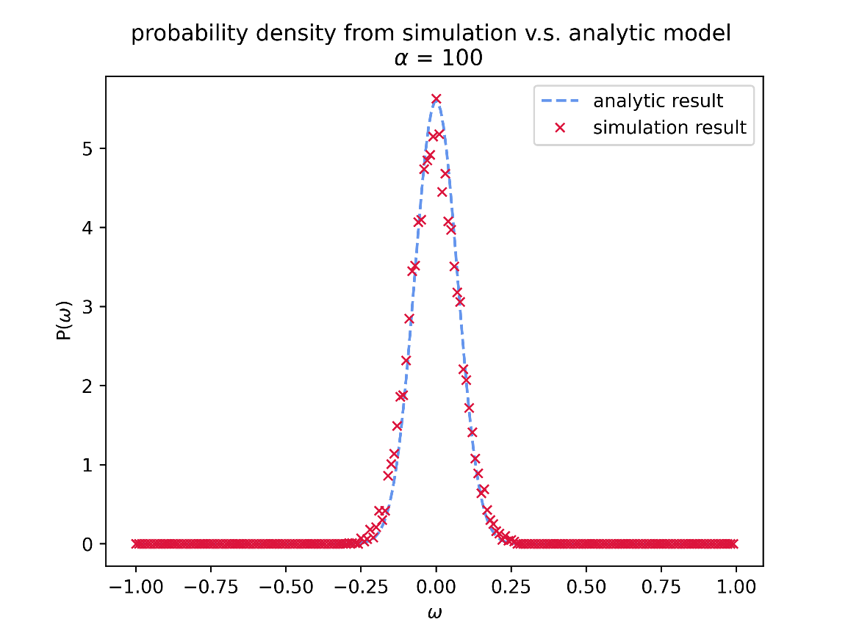
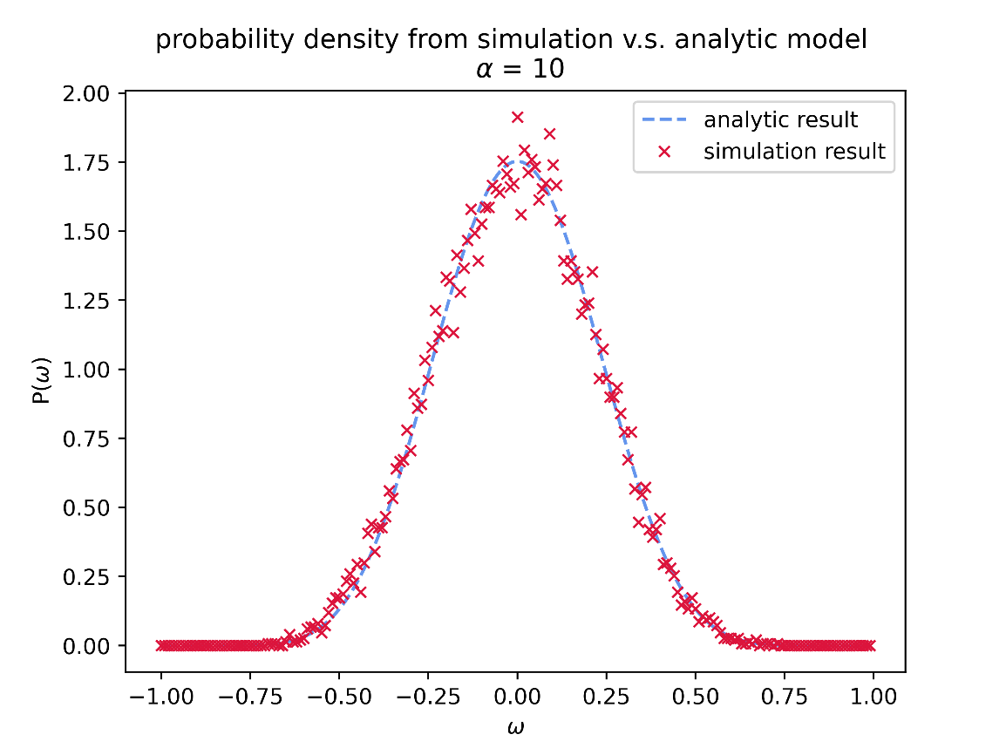
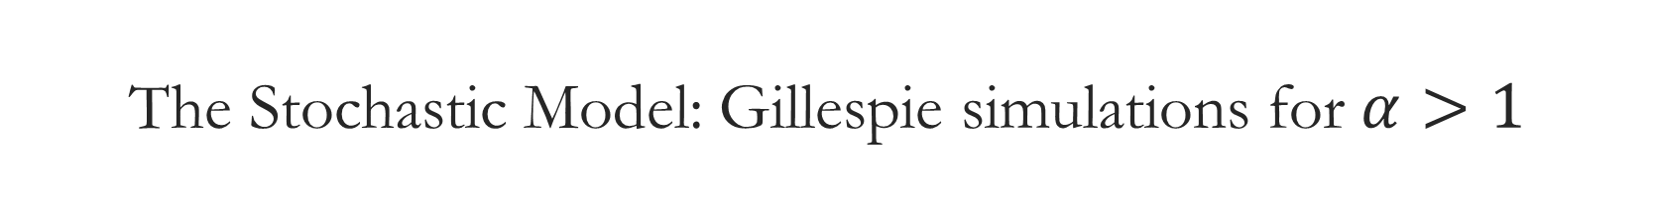
The Stochastic Model: Gillespie simulations for $α>1$

Slide 24
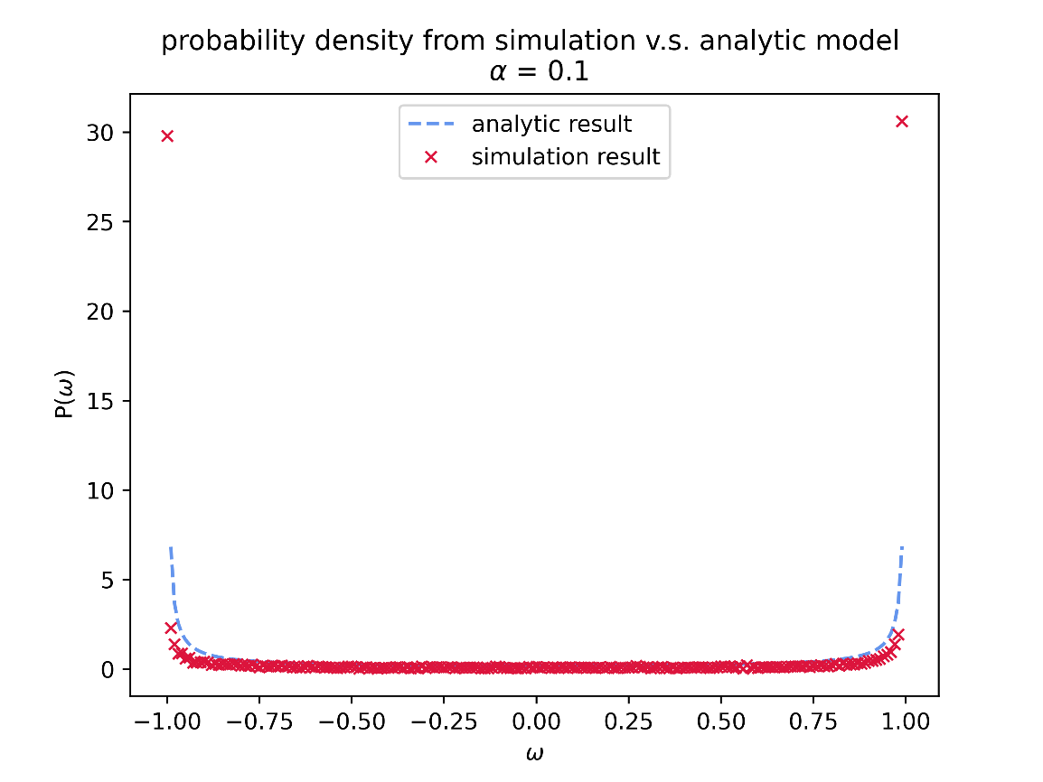
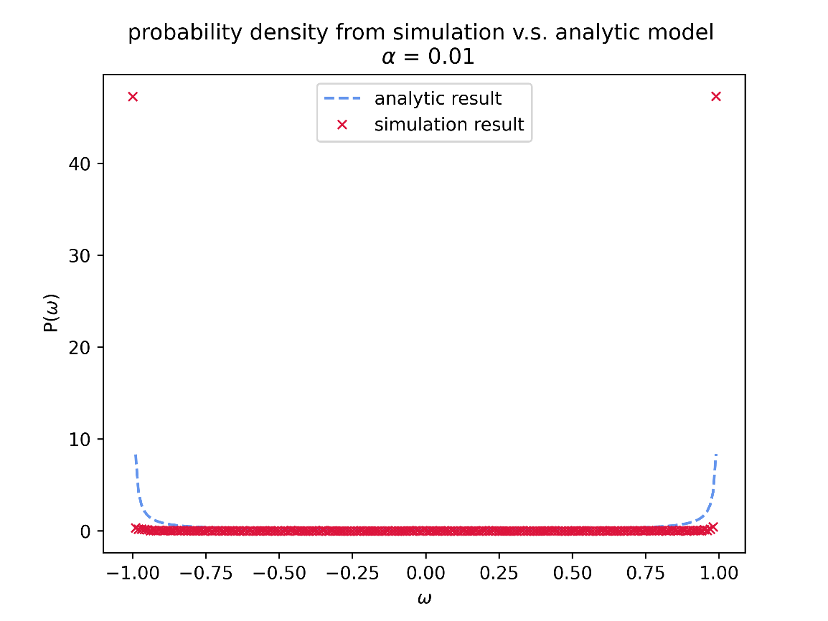

The Stochastic Model: Gillespie simulations for $α<1$

Slide 25
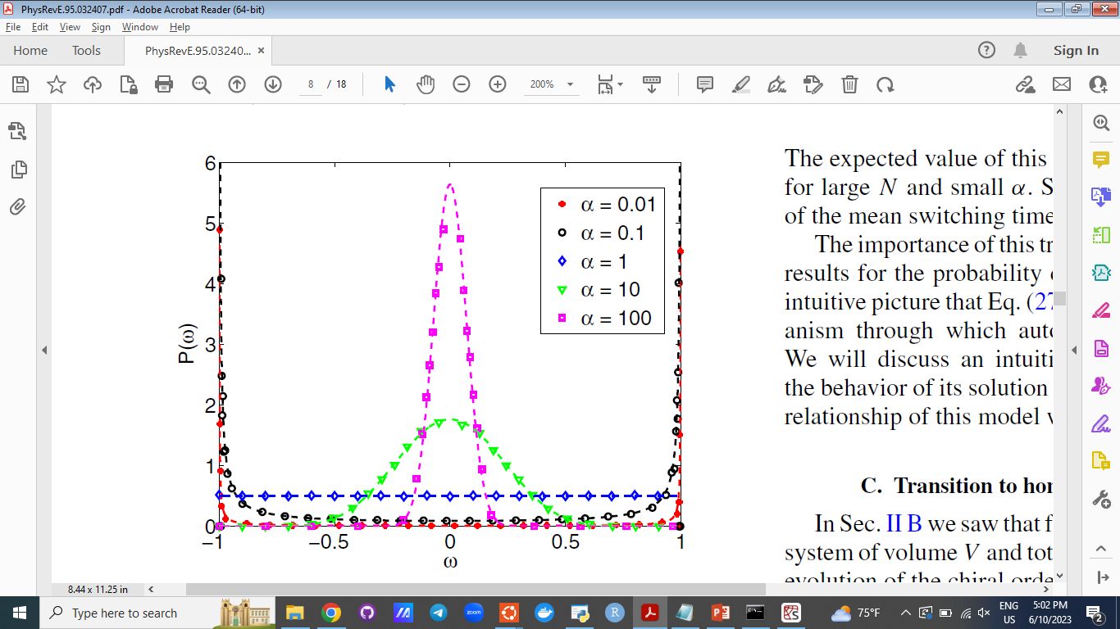
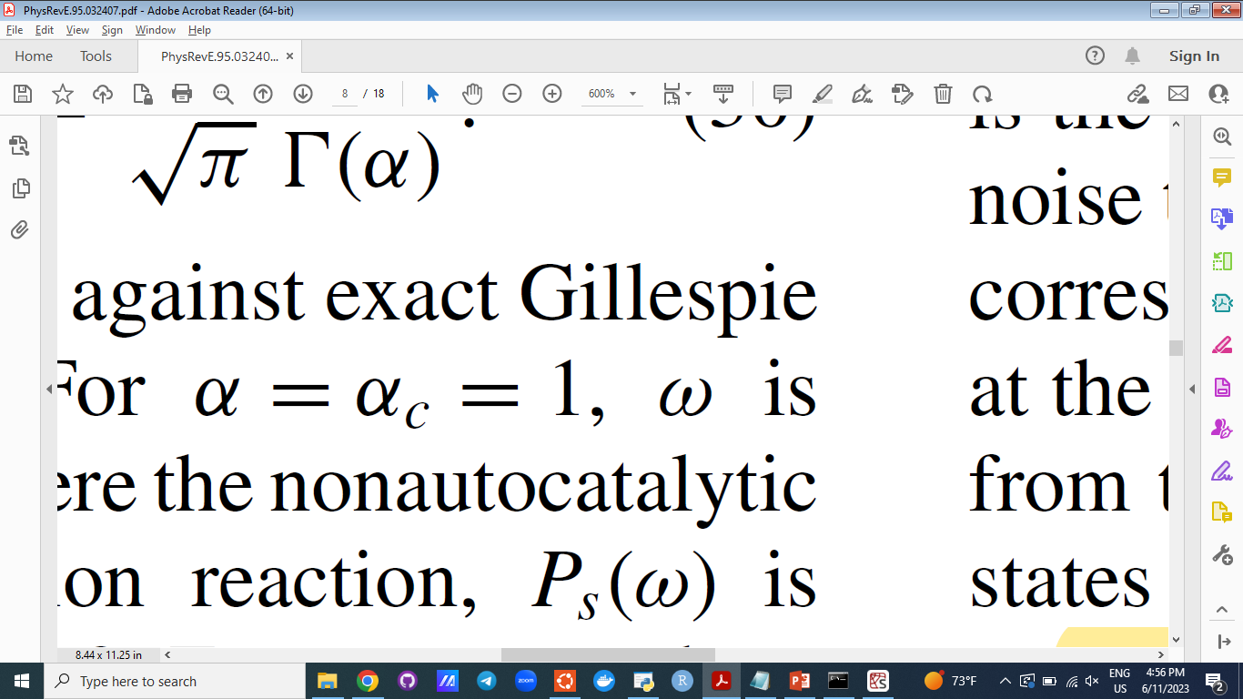
The Stochastic Model
Early life in earth
The parameter α is proportional to the ratio of the nonautocatalytic production rate, kn, to the self replication rate, ka.
As life evolved

Slide 26
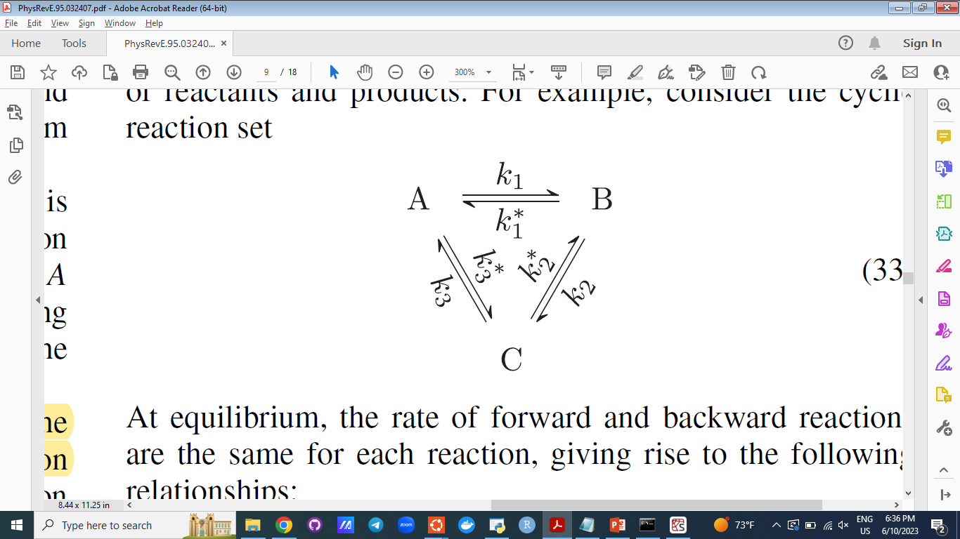
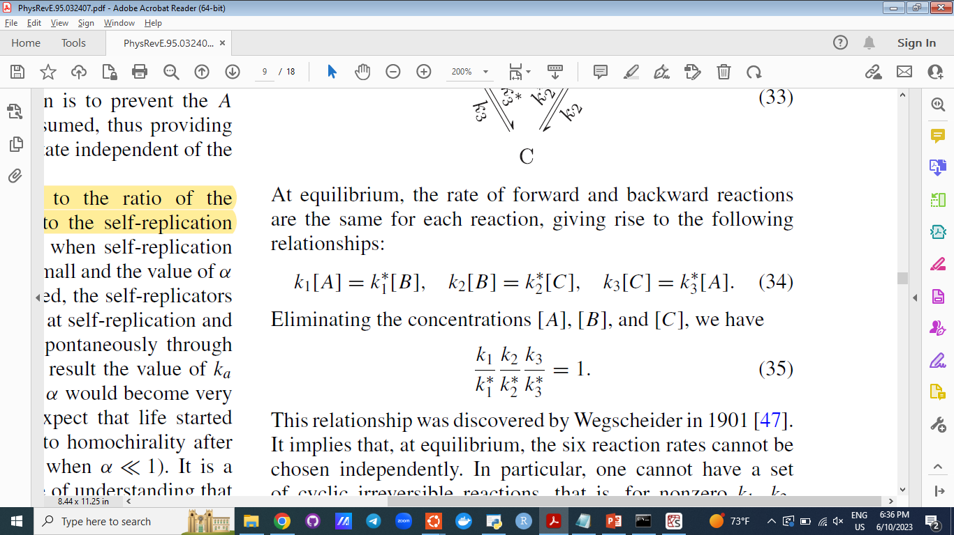

Thermodynamics of the System: principle of microscopic reversibility
the principle of microscopic reversibility states that at equilibrium, the rate of the forward reaction and the reverse reaction are equal for all reactions.
Wegscheider’s Condition

Slide 27
Thermodynamics of the System: Wegscheider’s Condition
The constants are constants! Therefore even away from equilibrium the condition should hold. In other words, Wegscheider’s condition is the condition for the existence of static equilibrium solution.
Wegscheider’s Condition

Slide 28
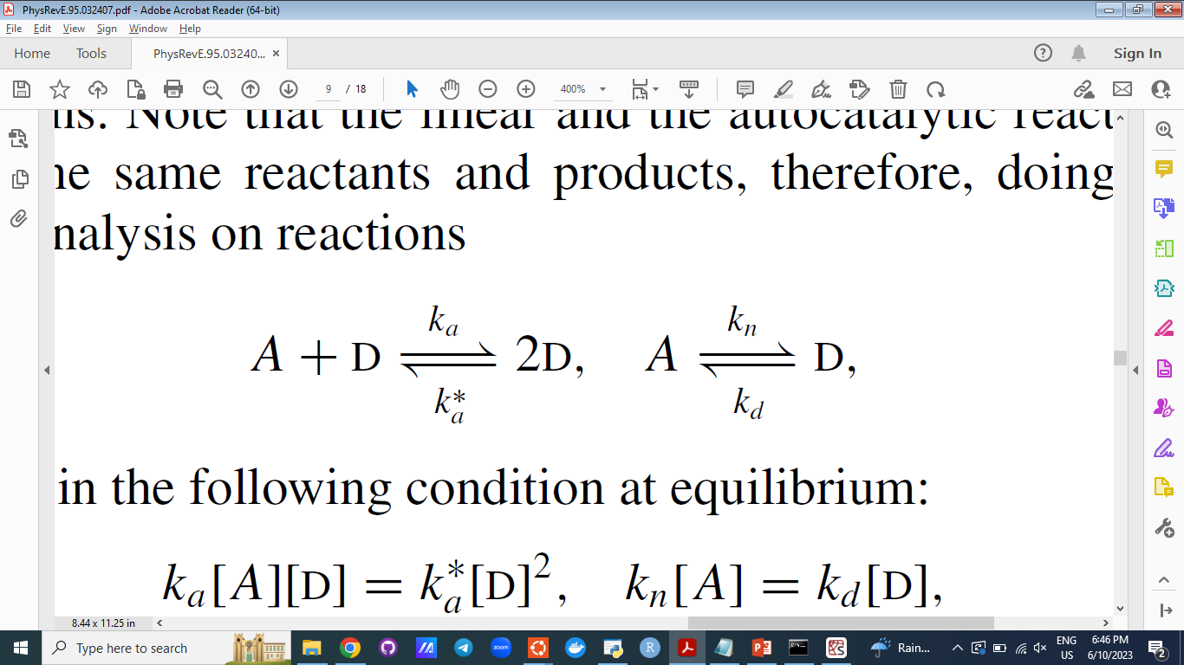
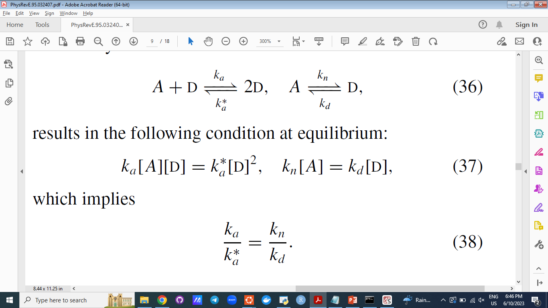

Thermodynamics of the System: Does our system have an equilibrium solution?
No!

Slide 29
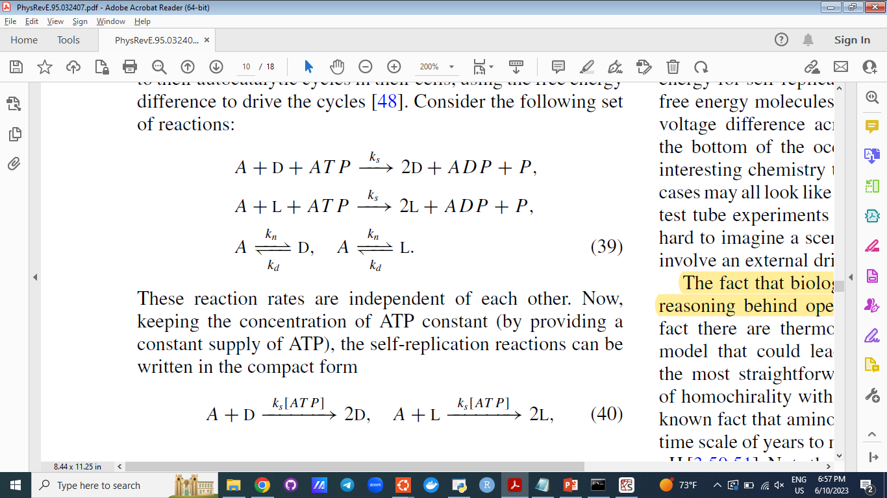
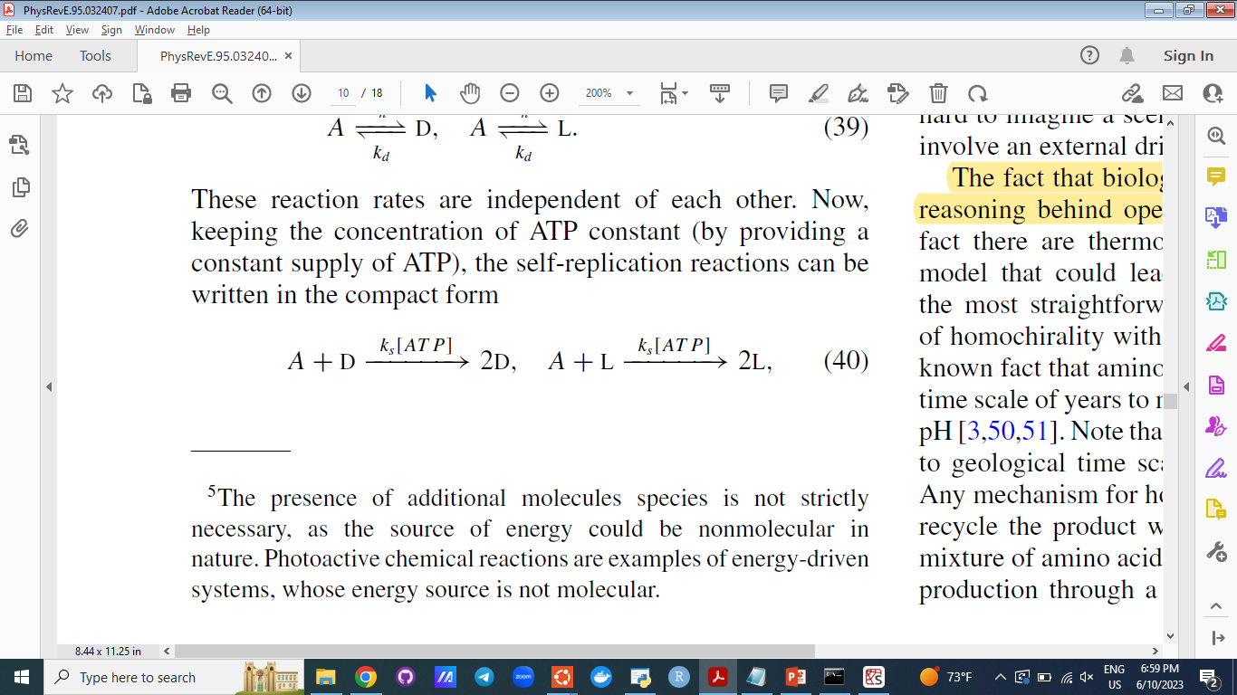
Thermodynamics of the System: closed-system set of reactions

Slide 30
Thermodynamics of the System: what are the evidence for the necessity of out of equilibrium conditions?
It is a fact that all biological systems are driven out of equilibrium.
But
There is more reasoning behind the assumption that the homochiral system is driven out of equilibrium:
there is no closed dilute system with a completely homochiral equilibrium.
G = U + pV − T S

Slide 31
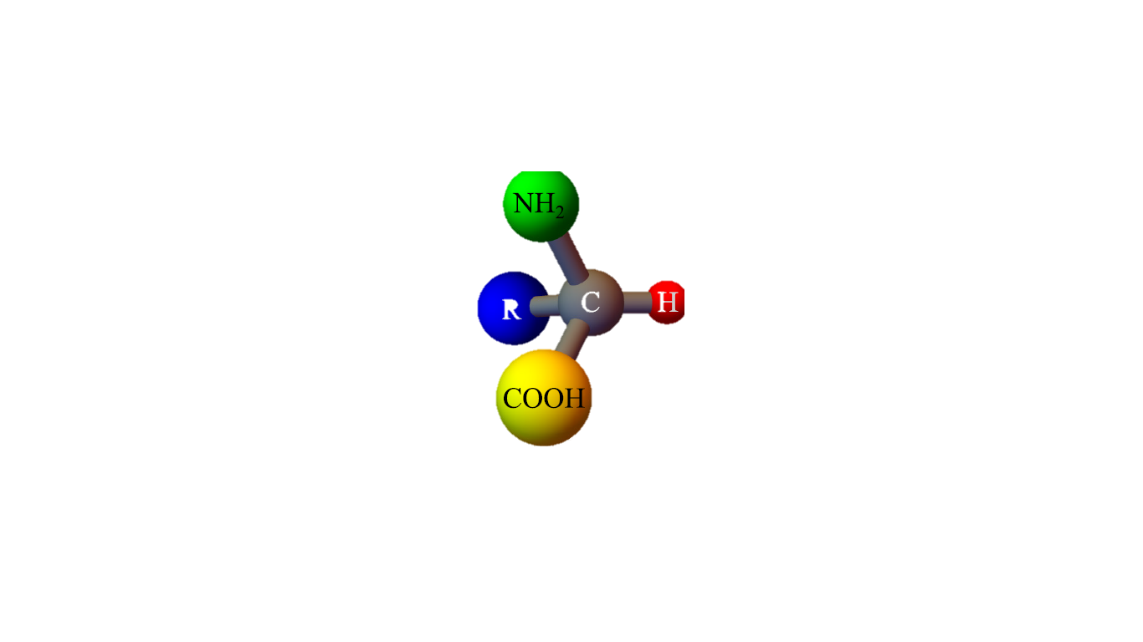
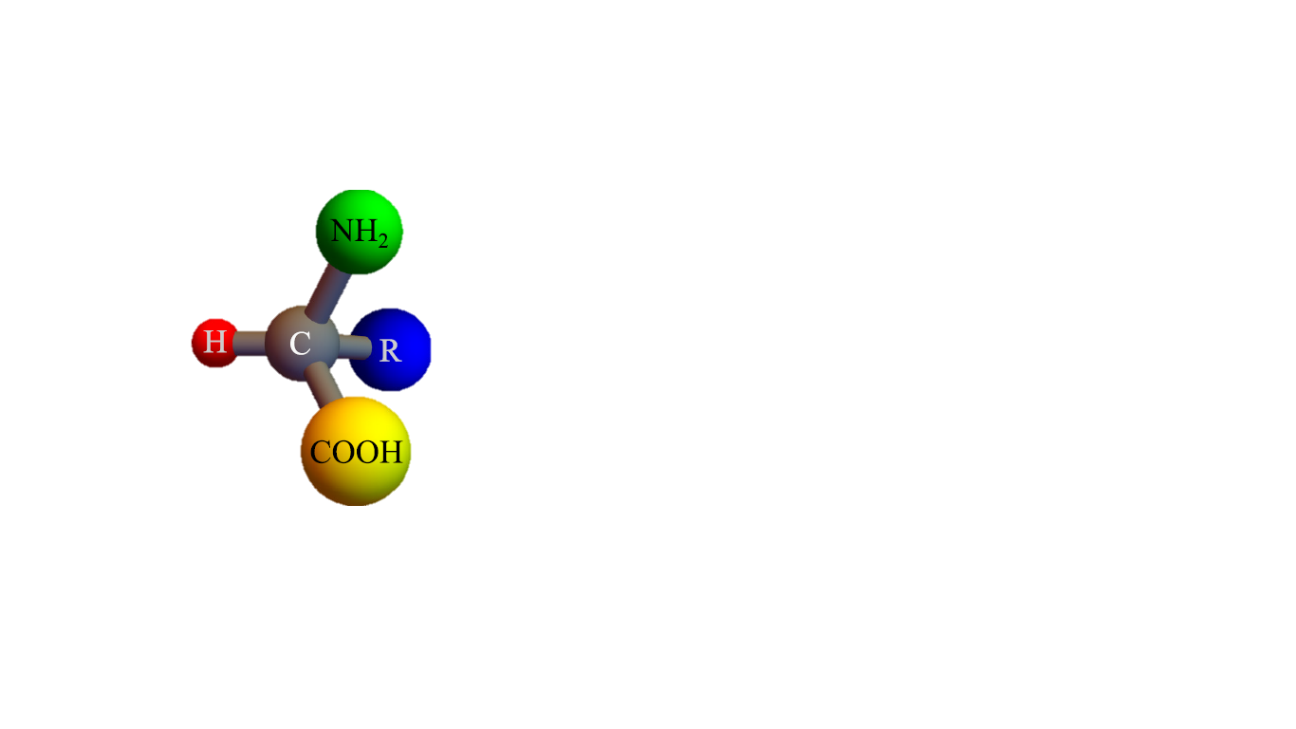
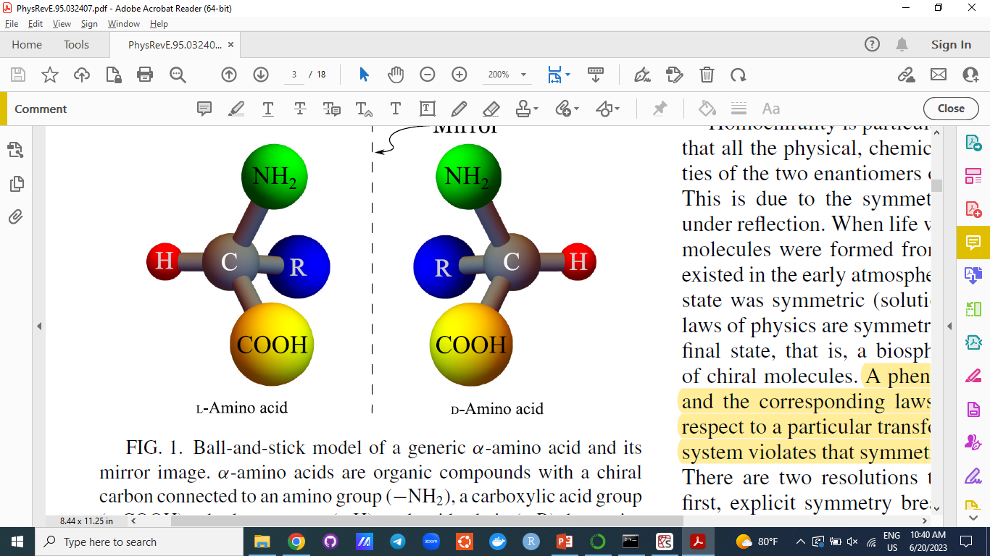
Thermodynamics of the System: is a homochiral equilibrium state possible?
Replace half with L-Amino Acids
A Pure Mixture of D-Amino acids (Homochiral)
Entropy S increases
A Racemic Mixture of D&L-Amino acids
G = U + pV − T S

Slide 32
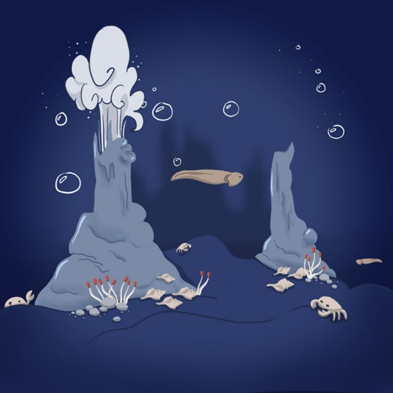
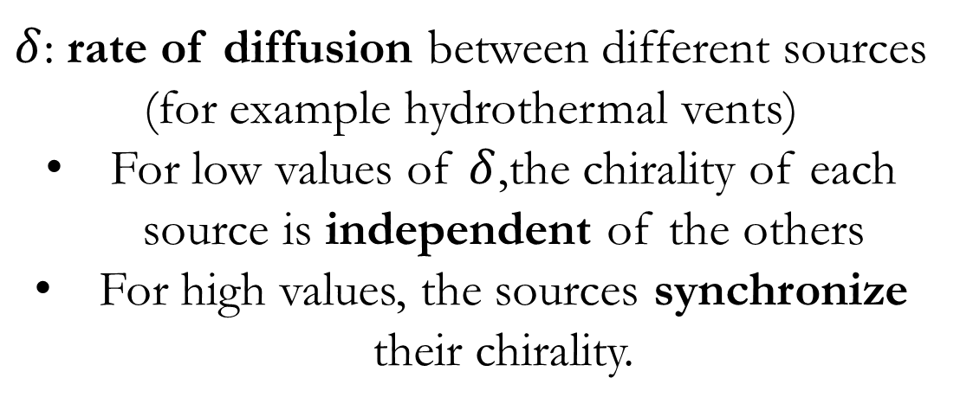
Homochirality: The Spatially Extended System
$δ$: rate of diffusion between different sources (for example hydrothermal vents)
For low values of $δ$,the chirality of each source is independent of the others
For high values, the sources synchronize their chirality.

Slide 33
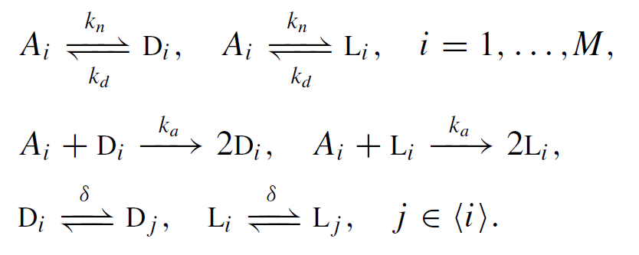
Homochirality: The Spatially Extended Model
# of sources
Neighbors of i

Slide 34
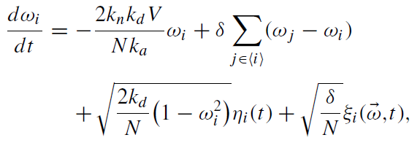
Homochirality: The Spatially Extended Model Results
correlated Gaussian noise

Slide 35

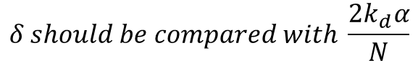
M = 2 Model: different $δ$ regimes
$$δ should be compared with \frac{2k_{d}α}{N}$$

Slide 36
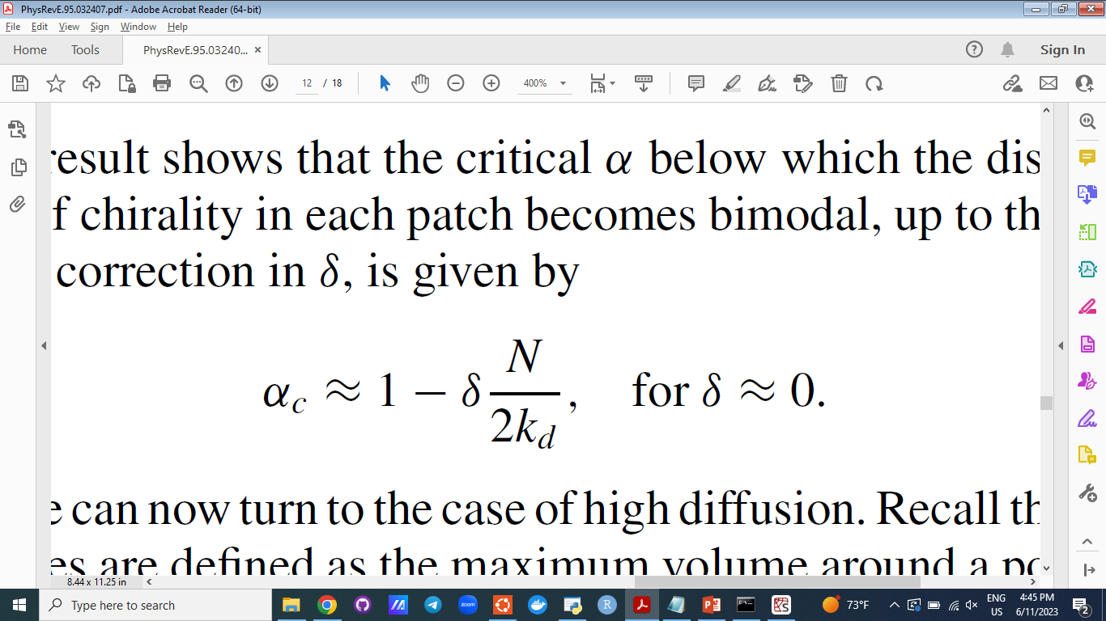
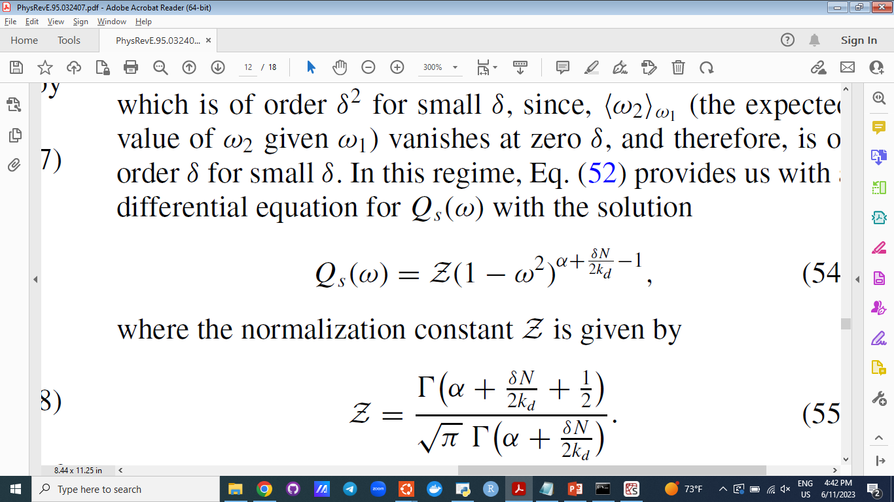

M = 2 Model: critical $α$ for low $δ$ regime

Slide 37
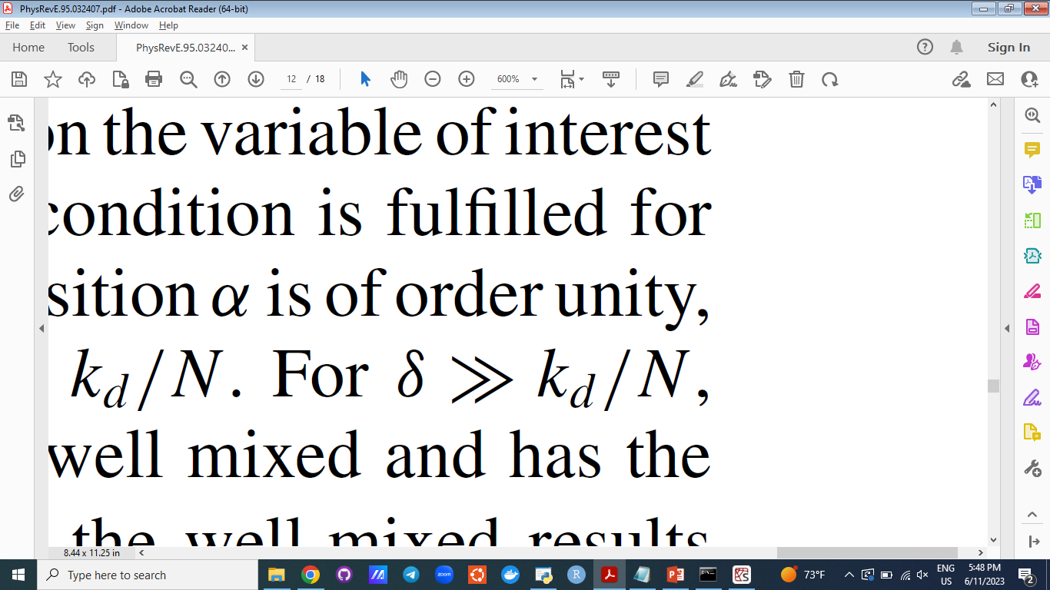
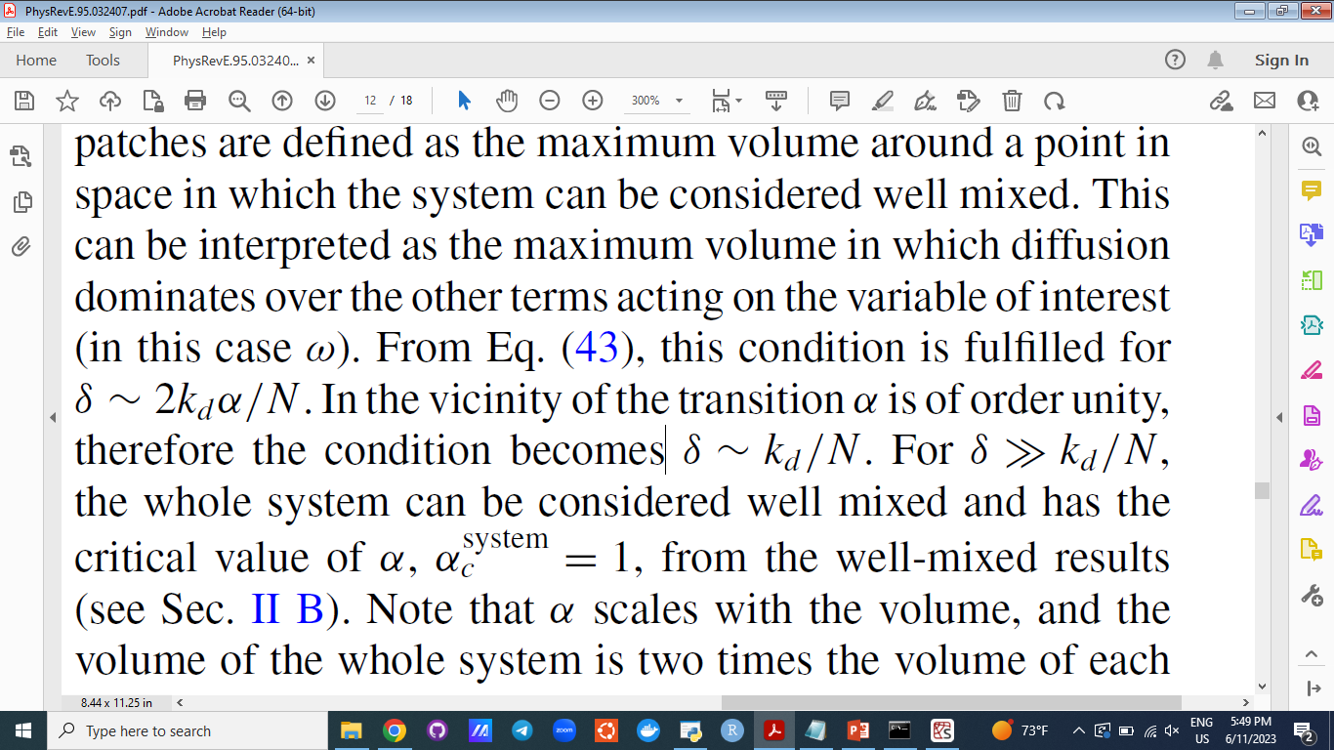
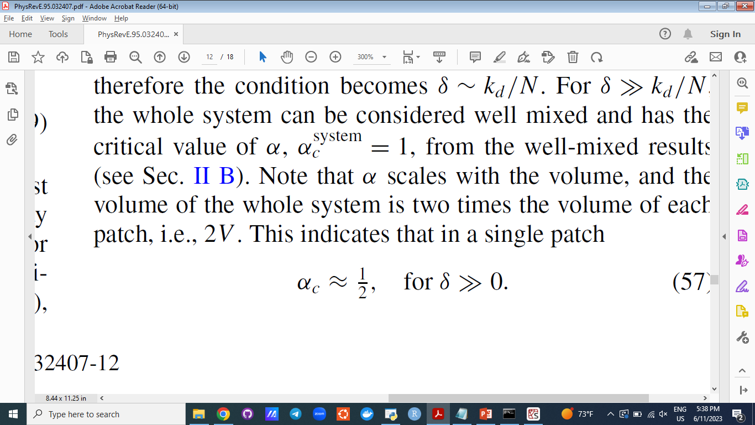

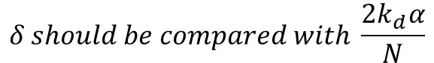
M = 2 Model: critical $α$ for high $δ$ regime
$$δ should be compared with \frac{2k_{d}α}{N}$$

Slide 38
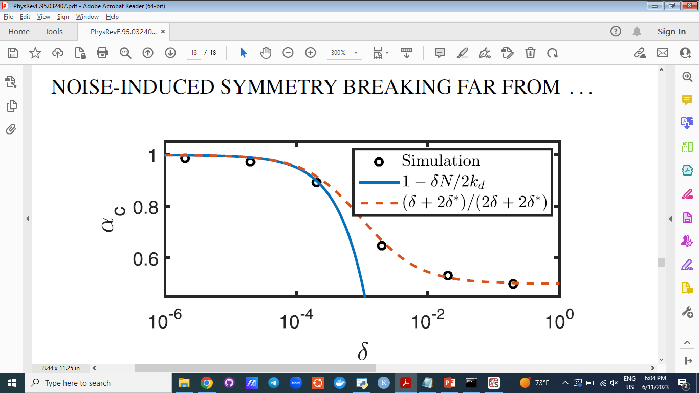
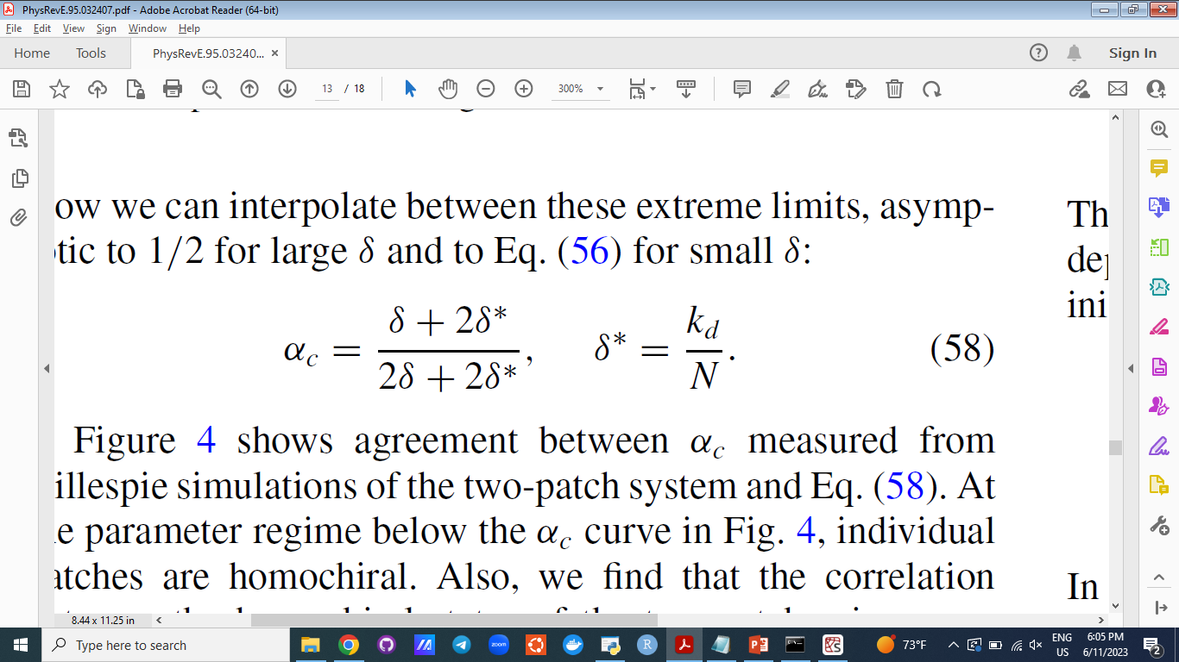
M = 2 Model: Robustness Analysis

Slide 39
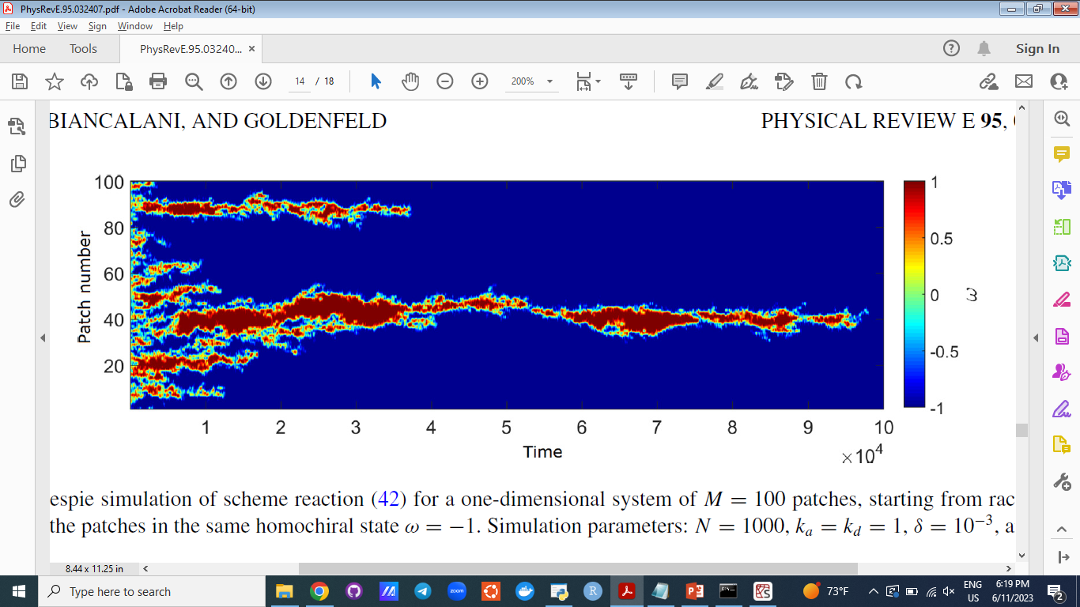
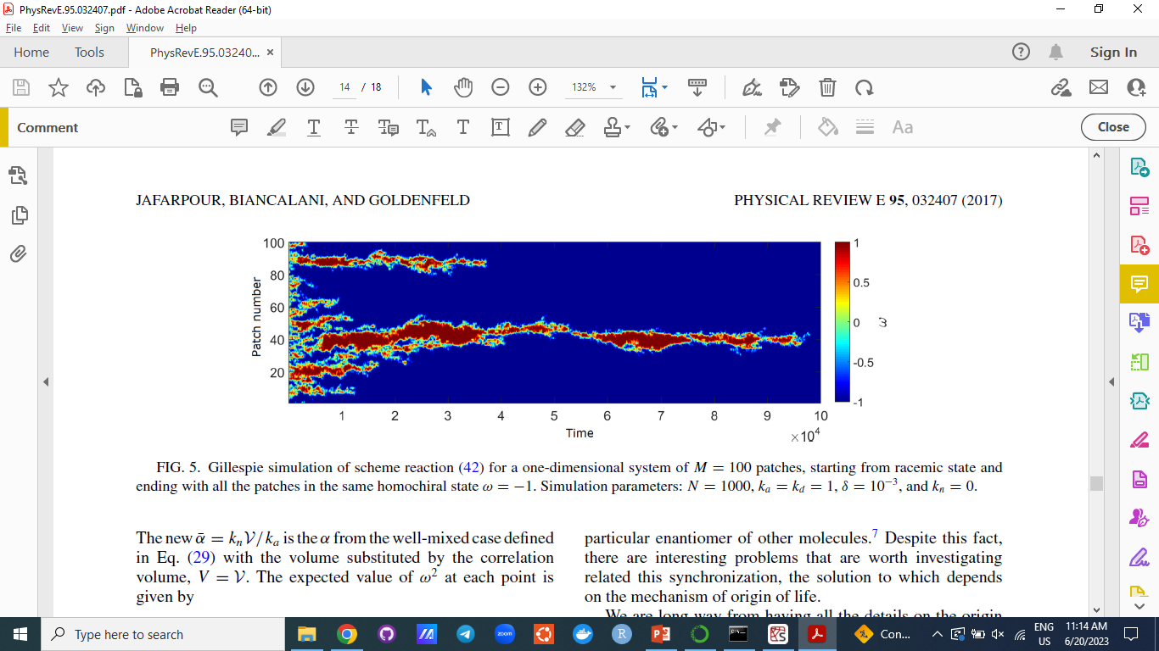
The Spatially Extended Model: Global Homochirality

Slide 40
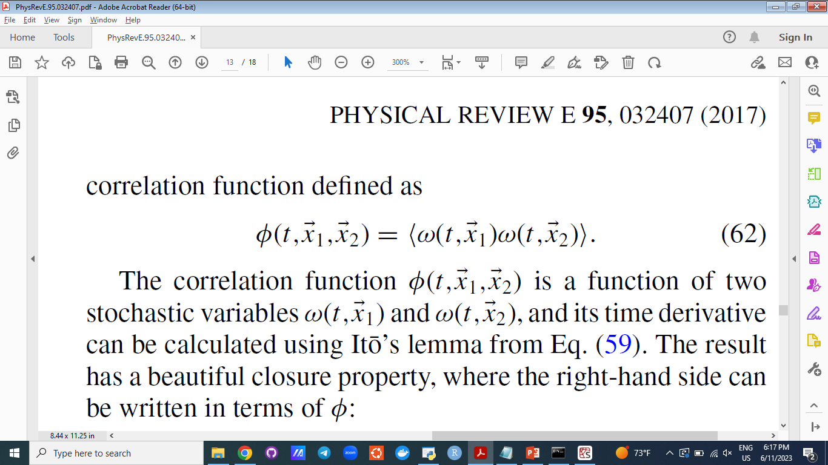
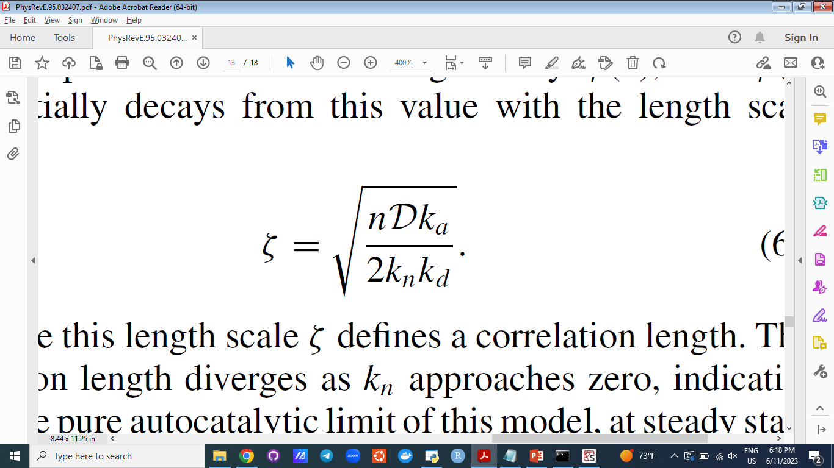
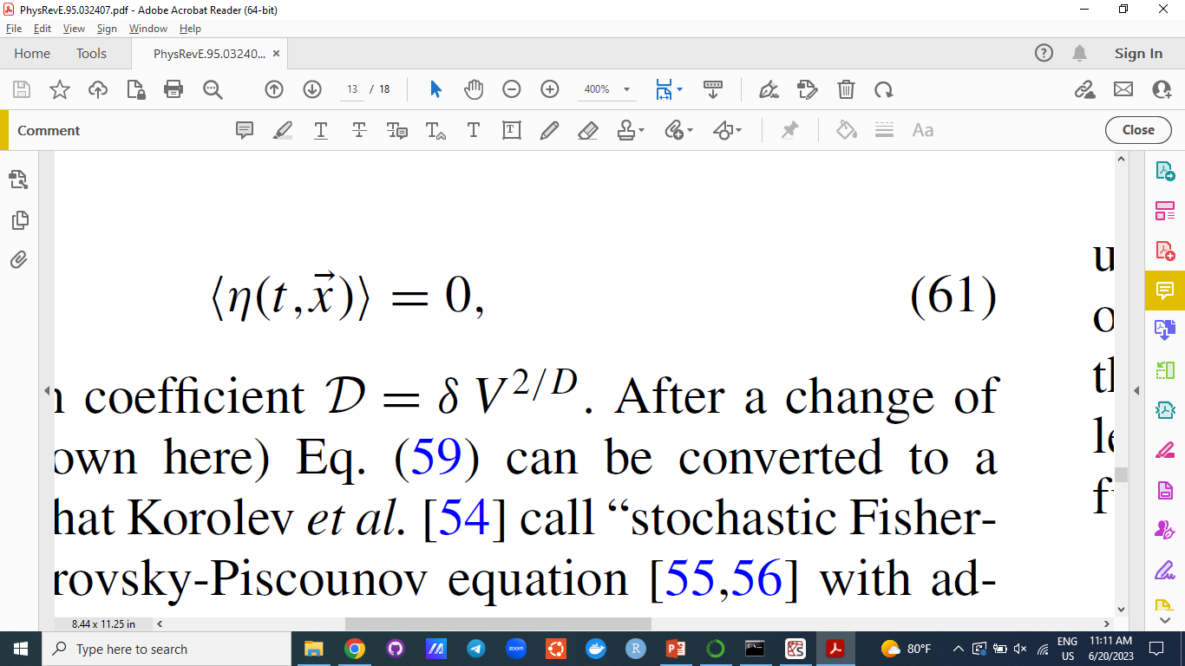
The Spatially Extended Model: Correlation Length

Slide 41
More On Derivations
Back to the Stochastic Model

Slide 42
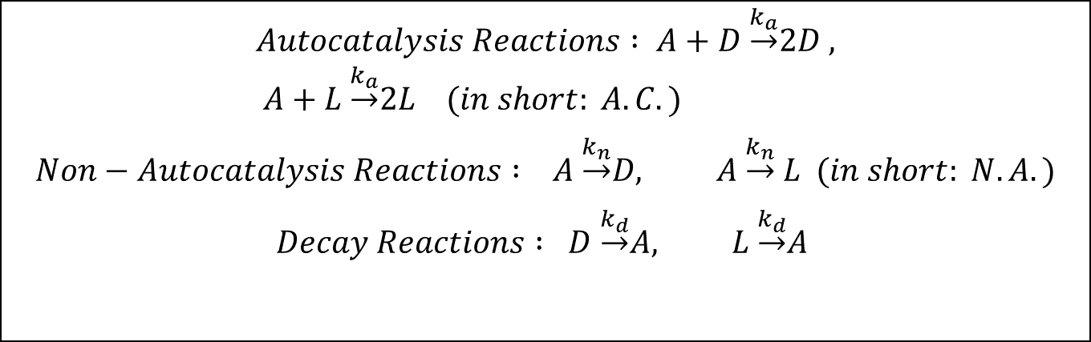
Analytical model
$$Autocatalysis Reactions : A+D \underset{→}{k_{a}}2D , A+L \underset{→}{k_{a}}2L (in short: A.C.)$$
$$Non−Autocatalysis Reactions : A \underset{→}{k_{n}}D, A \underset{→}{k_{n}} L (in short: N.A.)$$
$$Decay Reactions : D \underset{→}{k_{d}}A, L \underset{→}{k_{d}}A$$

Slide 43
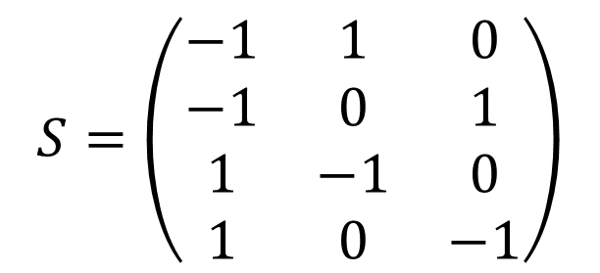





Stoichiometry Matrix $S$
A
D
L
$$S=\left(\begin{matrix}−1 & 1 & 0 \\ −1 & 0 & 1 \\ 1 & −1 & 0 \\ 1 & 0 & −1\end{matrix}\right)$$
$$Autocatalysis Reactions \& N.A.$$
$$Autocatalysis Reactions \& N.A.$$
$$Decay Reactions$$
$$Decay Reactions$$
$$(I)$$
$$s_{1}= \left(\begin{matrix}−1 \\ 1 \\ 0\end{matrix}\right) , s_{2}= \left(\begin{matrix}−1 \\ 0 \\ 1\end{matrix}\right) , s_{3}= \left(\begin{matrix}1 \\ −1 \\ 0\end{matrix}\right) , s_{4}= \left(\begin{matrix}1 \\ 0 \\ −1\end{matrix}\right)$$

Slide 44

Stoichiometry Matrix $S$
$$(I)$$
$$s_{1}= \left(\begin{matrix}−1 \\ 1 \\ 0\end{matrix}\right) , s_{2}= \left(\begin{matrix}−1 \\ 0 \\ 1\end{matrix}\right) , s_{3}= \left(\begin{matrix}1 \\ −1 \\ 0\end{matrix}\right) , s_{4}= \left(\begin{matrix}1 \\ 0 \\ −1\end{matrix}\right)$$
$s_{i}$ can be thought of, as a change in the state of the system $x= \left(\begin{aligned}{a \atop d} \\ l\end{aligned}\right)$

Slide 45



Transition Rates
$T(x+εs_{i}|x)$ represents the transition rate from state $x$ to the state $x+εs_{i}$
$T\left(x+εs_{1} | x\right)=reaction rate of N.A. ×concenteration of A+ reaction rate of A.C. × concenteration of A ×concenteration of D=\left(k_{n}+ k_{d}d\right)a$.

Slide 46

Transition Rates
(II)
$$T_{1}=T\left(x+εs_{1} | x\right)=\left(k_{n}+ k_{d}d\right)a , T_{2}=T\left(x+εs_{2} | x\right)=\left(k_{n}+ k_{d}l\right)a$$
$T_{3}=T\left(x+εs_{3} | x\right)=k_{d}d , T_{4}=T\left(x+εs_{4} | x\right)=k_{d}l$

Slide 47

Master Equation
$$\frac{\left.∂P(x,t\right)}{∂t}=V\sum_{i=1}^{4}{\left[T\left(x | x−εs_{i}\right)P\left(x−εs_{i} , t\right)−T\left(x+εs_{i} | x\right)P\left(x,t\right)] \right.}$$

Slide 48



Master Equation
$$\frac{\left.∂P(x,t\right)}{∂t}=V\sum_{i=1}^{4}{\left[T\left(x | x−εs_{i}\right)P\left(x−εs_{i} , t\right)−T\left(x+εs_{i} | x\right)P\left(x,t\right)] \right.}$$
By defining $F_{i}(x,t)= T\left(x+εs_{i} | x\right)P\left(x,t\right)$
$$\frac{\left.∂P(x,t\right)}{∂t}=\sum_{i=1}^{4}{\frac{F_{i}\left(x−εs_{i}\right)−F_{i}(x,t) }{ε} }$$

Slide 49


Master Equation
$$\frac{F_{i}\left(x−εs_{i}\right)−F_{i}(x,t) }{ε}= −\sum_{j=1}^{3}{S_{ij}\frac{∂F_{i}}{∂x_{j}}}+ \frac{1}{2}\sum_{j=1, k=1}^{3,3}{S_{ij}S_{ik}\frac{∂^{2}F_{i}}{∂x_{j}∂x_{k}}+… }$$
$$→\frac{\left.∂P(x,t\right)}{∂t}=−\sum_{i,j}{S_{ij}\frac{∂F_{i}}{∂x_{j}}}+ \frac{1}{2}\sum_{i,j,k}{S_{ij}S_{ik}\frac{∂^{2}F_{i}}{∂x_{j}∂x_{k}}+… }$$

Slide 50



Master Equation
$$\frac{\left.∂P(x,t\right)}{∂t}=−\sum_{i,j}{S_{ij}\frac{∂F_{i}}{∂x_{j}}}+ \frac{1}{2}\sum_{i,j,k}{S_{ij}S_{ik}\frac{∂^{2}F_{i}}{∂x_{j}∂x_{k}}+… }$$
R$emember: F_{i}(x,t)= T\left(x+εs_{i} | x\right)P\left(x,t\right)$
$$H= \sum_{i}{s_{i}T_{i}=T_{1}\left(\begin{matrix}−1 \\ 1 \\ 0\end{matrix}\right)+T_{2}\left(\begin{matrix}−1 \\ 0 \\ 1\end{matrix}\right)+ T_{3} \left(\begin{matrix}1 \\ −1 \\ 0\end{matrix}\right)+ T_{4}\left(\begin{matrix}1 \\ 0 \\ −1\end{matrix}\right) }$$

Slide 51

Drift Vector H
(III)
$$→H= \left(\begin{matrix}k_{d}\left(d+l\right)−a(2k_{n}+k_{a}\left(d+l\right)) \\ −k_{d}d+a(k_{n}+k_{a}d) \\ −k_{d}l+a(k_{n}+k_{a}l)\end{matrix}\right)$$

Slide 52




Diffusion Matrix
Concentrate only on the first transition, namely index $i=1$
$$\frac{1}{2}\sum_{j=1, k=1}{S_{1j}S_{1k}\frac{∂^{2}F_{1}}{∂x_{j}∂x_{k}} }=\frac{1}{2}\sum_{j=1, k=1}{\frac{\left.∂^{2}{\left(S_{1j}S_{1k}T\right.}_{1 }×P\right)}{∂x_{j}∂x_{k}} }$$
But we should repeat this for all the other three transitions and sum them all to get the right $B:$
$$B= \sum_{i}{s_{i}⊗s_{i} T_{i}}$$
$$s_{1}= \left(\begin{matrix}−1 \\ 1 \\ 0\end{matrix}\right)$$
$$B considering only transition 1= \left(\begin{matrix}1 & −1 & 0 \\ −1 & 1 & 0 \\ 0 & 0 & 0\end{matrix}\right) × T_{1}$$

Slide 53

The Fokker Planck Equation
(IV)
$$\frac{∂P(x,t)}{∂t}=−\sum_{j}{\frac{∂(H_{j}P)}{∂x_{j}}}+ \sum_{j,k}{\frac{∂^{2}(B_{jk}P)}{∂x_{j}∂x_{k}}+… }$$

Slide 54

The Langevin Equation
(V)
$$\frac{dx}{dt}=H\left(x\right)+G(x)η(t)$$
Where, $G$ satisfies the relation $GG^{T}=B$ and $η(t)$ is a Gaussian white noise.

Slide 55


The Stochastic Model
$$\frac{dω}{dt}=−2\frac{k_{n}k_{d}}{k_{a}} \frac{V}{N} ω+ \sqrt{{2k_{d}(1−ω^{2}) }/N }η$$
$$P_{s}\left(ω\right)= ℕ^{−1}{(1−ω^{2})}^{1− α}, with α= \frac{k_{n}V}{k_{a}}$$

